Slide 1
WorthTheWeight
Storyboard Capstone
Katelynn Dunn

Slide 2
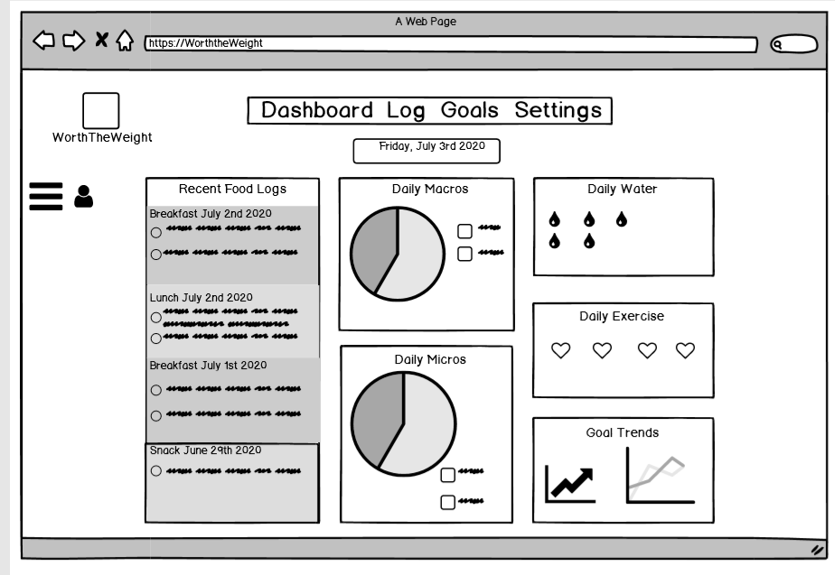
Dashboard Page
Once a user logs into account, this is the page they are shown.
User can be directed back to this page by clicking “Dashboard” in the navigation bar at the top of the web page.
User can access Log page by clicking on “Log” in the navigation bar at the top of the page.
User can access Goals page by clicking on “Goals” in the navigation bar at the top of the page.
User can access Settings page by clicking on “Settings” in the navigation bar at the top of the page.
They can also click the “WorthTheWeight” Icon which will direct them to the dashboard.
User can look at overview of daily specifics on dashboard.
User can access their profile information and notifications by clicking hamburger menu in top left corner.
When a user clicks on recent food logs, daily macros and micros, daily water and daily exercise it takes them to the log page.
When a user clicks on goal trends, it takes them to the goal page.

Slide 3
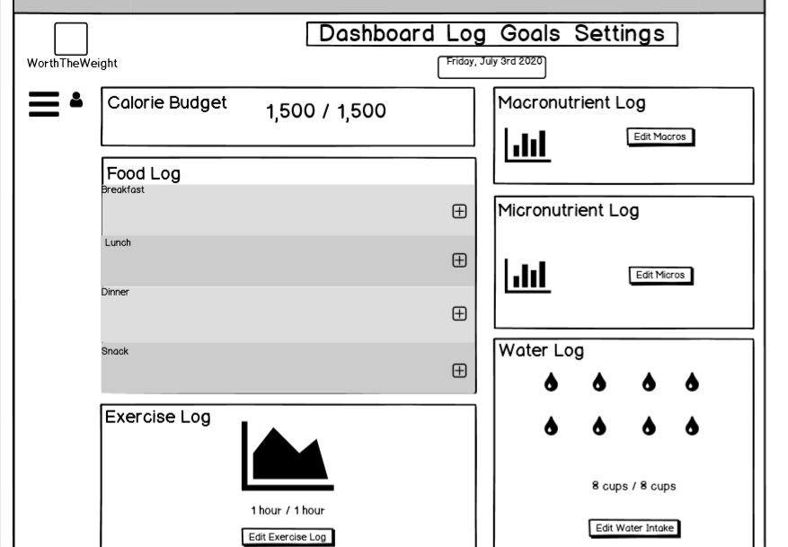
Log Page
User can access this page by clicking “Log” in the navigation bar.
User can access Dashboard by clicking “Dashboard” in the navigation bar at the top of the page.
User can access Goals by clicking “Goals” in the navigation bar at the top of the page.
User can access Settings page by clicking “Settings” in the navigation bar at the top of the page.
User can access the Dashboard by clicking the “WorthTheWeight” icon in the top left.
User can access their profile information and notifications by clicking on the hamburger menu in the top left of the page.
User can add/edit food items to meals of the day by clicking on the plus icon in the right of the meal.
User can edit/add exercise by clicking the “Edit Exercise Log” button.
User can edit/add macronutrients by clicking “Edit Macros” button
User can edit/add micronutrients by clicking “Edit Micros” button
User can edit/add water by clicking the “Edit Water Intake” button.

Slide 4
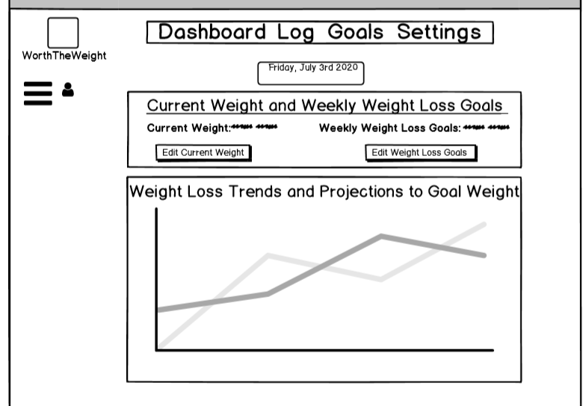
Goals Page
User can access this page by clicking on “Goals” in the navigation bar.
User can access Dashboard page by clicking “Dashboard” in the navigation bar at the top of the page
User can access Log page by clicking “Goals” in the navigation bar at the top of the page.
User can access Settings page by clicking “Settings” in the navigation bar at the top of the page.
User can edit current weight by clicking the “Edit Current Weight” button
User can edit weekly weight loss goals by clicking the “Edit Weight Loss Goals”
User can access profile information and notifications when clicking hamburger menu in top left corner.
When a user clicks the “WorthTheWeight” icon, they will be directed to the dashboard.

Slide 5
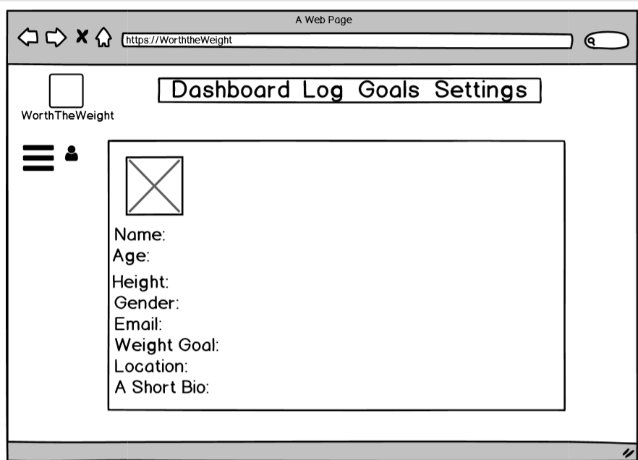
Settings/Profile Page
User can access this page by clicking “Settings” in the navigation bar.
User can access Dashboard by clicking “Dashboard” in the navigation bar at the top of the page.
User can access Goals by clicking “Goals” in the navigation bar at the top of the page.
User can access Log page by clicking “Log” in the navigation bar at the top of the page.
User can access the Dashboard by clicking the “WorthTheWeight” icon in the top left.
User can access their profile information and notifications by clicking on the hamburger menu in the top left of the page.
User can edit/add picture to profile by clicking on profile picture image placeholder.
User can edit/add Name, Age, Height, Gender, Email, Weight Goal, Location and Short Bio by clicking in empty space next to area and typing in information.

Slide 6
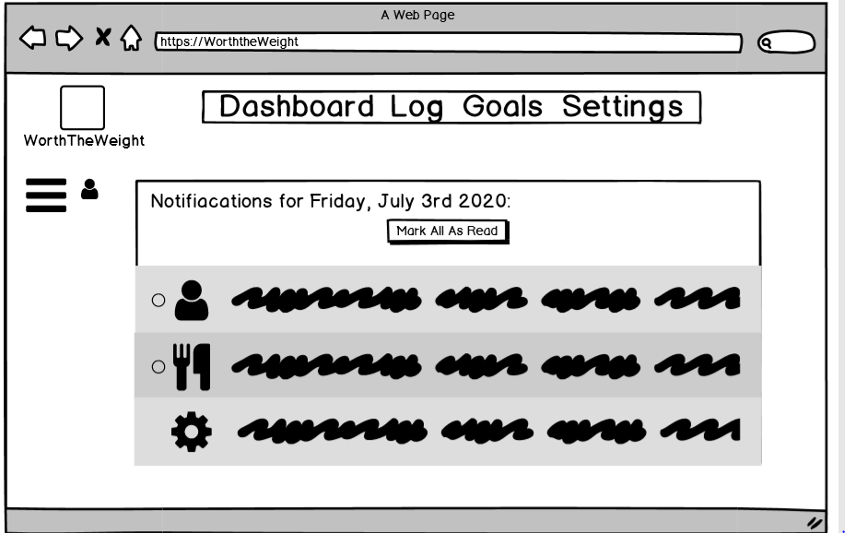
Notifications Page
User can access this page by clicking the hamburger menu in the top left of the screen.
User can access Dashboard by clicking “Dashboard” in the navigation bar at the top of the page.
User can access Goals by clicking “Goals” in the navigation bar at the top of the page.
User can access Settings page by clicking “Settings” in the navigation bar at the top of the page.
User can access Log by clicking “Log” in the navigation bar at the top of the page.
User can access the Dashboard by clicking the “WorthTheWeight” icon in the top left.
User can mark all of their notifications as read by clicking the “Mark All As Read” button.

Slide 7
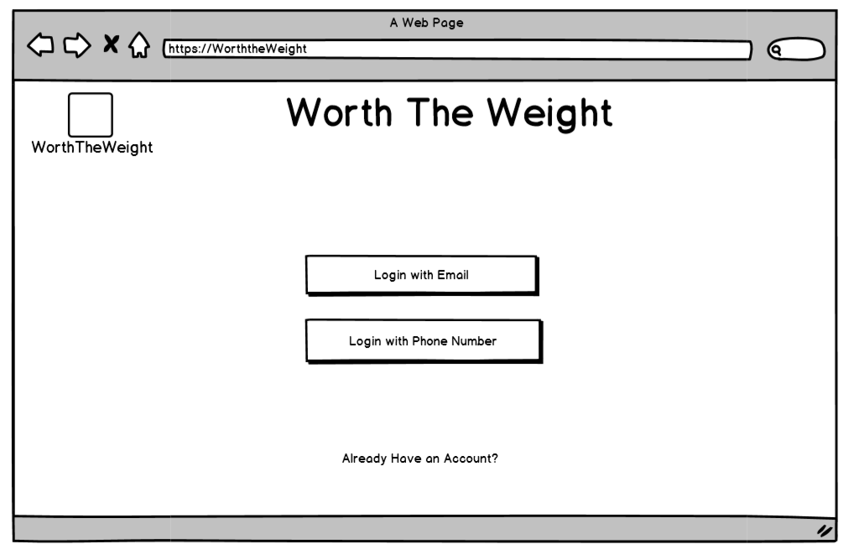
Login Page
Users can login with email by clicking the “Login with Email” button
Users can login with phone number by clicking the “Login with Phone Number” button
Users can click the “Already have an Account?” link to access the return user login screen.
Users who are not logged in that click the “WorthTheWeight” icon will be brought to this page.

Slide 8
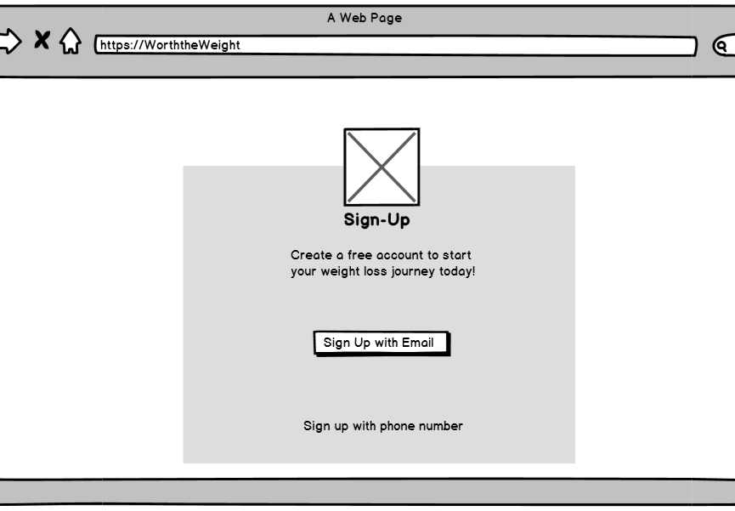
Sign-Up with Email Page
Users can sign up for a new account with an email by clicking the “Sign Up with Email” button.
Users can access sign up with phone number page by clicking “Sign up with phone number” link.

Slide 9
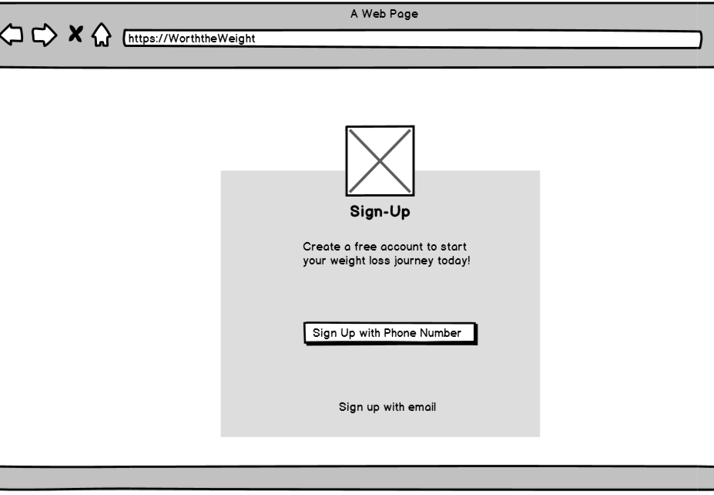
Sign-Up with Phone Number Page
Users can sign up for a new account with a phone number by clicking the “Sign Up with Phone Number” button.
Users can access the sign up with email page by clicking the “Sign up with email” link.

Slide 10
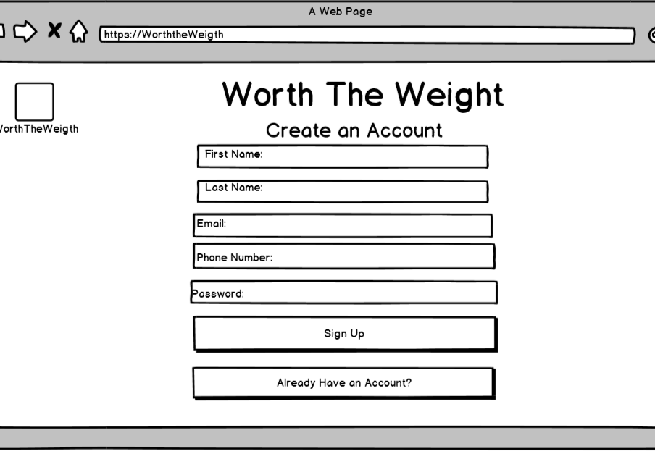
Create an Account Page
Users can add first name, last name, email, phone number and password by clicking in the box and typing out what is asked.
Users can sign up for an account by filling out the first name, last name, email, phone number and password fields and clicking the “Sign Up” button.
Users can access the returning user login page by clicking the “Already Have an Account?” button.
Users can be brought back to the main login page by clicking the “WorthTheWeight” icon.

Slide 11
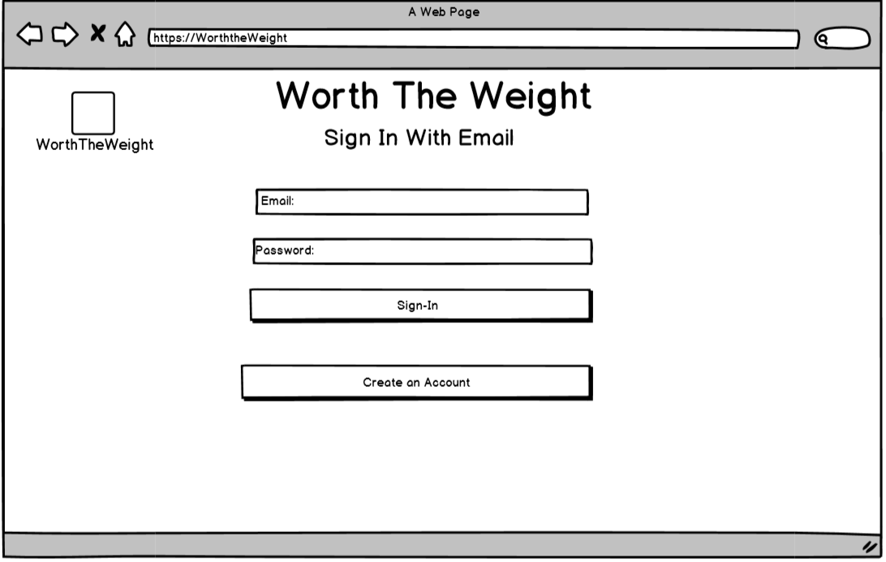
Sign-In with Email Page
Users can enter in email and password by clicking in boxes and typing out designated field.
User can sign into an existing account by filling in email and password fields and clicking the “Sign In” button.
User can access the create an account page by clicking the “Create an Account” button.
Users can access main login page by clicking “WorthTheWeight” icon.

